Slide 1


MAYA : Magical AI, Your Assistant
“Revolutionizing The Way We Interact With Technology”

Slide 2
Outline
• Introduction
• Objectives of the Project
• Technologies Used
• APIs Used
• Libraries and Modules Used
• Functionality Overview
• Future Improvements
• Conclusion

Slide 3
Introduction
In a world driven by technology and automation, voice assistants have become an integral part of our daily lives. Meet MAYA, the Magical AI, Your Assistant, a powerful and versatile digital companion designed to make your life easier and more efficient.
MAYA stands for "Magical AI, Your Assistant" Whether you're looking for answers to questions, need assistance with tasks, or simply want to control your digital world effortlessly, MAYA is here to help.
With over 30 diverse functionalities, MAYA is more than just a voice assistant, it's your personal assistant, your entertainer, and your information hub. From managing applications, searching the web, and checking the weather to sending messages and performing complex calculations, MAYA is your go-to solution for a smarter and more productive life

Slide 4
Objectives of the project
The code initializes and sets up the virtual assistant named "Maya." - It can perform tasks such as opening applications (e.g., web browsers, text editors), searching the web, sending messages, retrieving information from Wikipedia, providing weather updates, news headlines, and jokes.
It can interact with the user via speech. The virtual assistant can perform system-related tasks like changing the desktop wallpaper, adjusting system volume, taking screenshots, and managing tasks.
It can set alarms, calculate answers to questions, translate text, and even control media playback (e.g., pausing and playing videos).
The code uses external APIs and services, such as Wolfram Alpha, Google Maps, and news APIs, to fetch information.

Slide 5
Team Members & Role
Gudipudi Rushitha :- primarily focus on the development of the core functionalities and the backend of the voice assistant system. like Voice Recognition, Functionality Integration, User Interactions with voice commands.
Dandigala Deepthi :- primarily focus on creating the user interface and ensuring a seamless and user-friendly experience when interacting with MAYA along with this Thoroughly test the core functionalities, identify and fix bugs, and optimize performance.

Slide 6

Technologies Used
Speech recognition: (e.g., Google Speech Recognition)
Text-to-speech: (e.g., Google Text-to-Speech API)
Web scraping: (e.g., Beautiful Soup for Wikipedia)
Hardware monitoring: (e.g., system battery level, internet speed)
Note-taking: (e.g., Notepad)
IP address retrieval: (e.g., Python's socket library)
Screenshot capture: (e.g., Python's Pillow library)

Slide 7
Libraries Used
psutil : For retrieving system information and performance statistics.
speedtest : For checking internet speed.
Geopy : For geolocation services.
Pywhatkit : For sending WhatsApp messages
pyautogui : For GUI automation.
PyQt5 : A GUI library for creating graphical user interfaces.
os : For handling file operations and system-related tasks.
datetime : Used for working with dates and times
speech_recognition : For speech recognition.

Slide 8

Calendar : Provides calendar-related functions.
plyer.notification : Used for displaying notifications.
pygame.mixer : Used for playing audio.
Warnings : Imported for avoiding warnings.
Pyjokes : To generate jokes.
Gtts : Google Text-to-Speech for text-to-speech convers
Pyttsx3 : Used for text-to-speech conversion:
Webbrowser : Allows performing web searches.

Slide 9
API Keys Used
OpenWeather API :- Used for Retriving Weather data. allows developers to easily access a wide range of weather data for various locations .
Twilio AP :- The Twilio REST API allows you to query metadata about your account, phone numbers, calls, text messages, and recordings.
wolframalpha API :- Integration with the Wolfram Alpha computational knowledge engine for peforming Mathematical calculations .
News API :- It is a simple JSON-based REST API for searching and retrieving news articles from all over the web.

Slide 10

Functionality Overview .
Say Date and Time :- When the user says "What's the date?" or "Tell me the time," the voice assistant responds with the current date and time.- The code uses Python's datetime module to retrieve the date and time
Answer General Questions :- The voice assistant is capable of answering general questions posed by the user.
Open Applications :- Users can open various apps like Microsoft Word, PowerPoint, Excel etc...

Slide 11



﻿ 4. Search in Wikipedia :- The voice assistant can search for information in Wikipedia. It performs web scraping to retrieve data from the Wikipedia website
5. Search in YouTube and Google :- Users can initiate web searches and find YouTube videos through voice commands.-The voice assistant likely sends search queries to search engines like Google or YouTube's API to retrieve results.
6. Change System Background :- The assistant allows users to change the system's desktop background or wallpaper using voice commands.

Slide 12



7. Play Music :- 11/ Users can request the voice assistant to play music.- the code interact with a music player application to play music.
8. Empty Recycle Bin :- The assistant provides a way to empty the Recycle Bin or Trash on the system. It use system-specific commands to delete files in the Recycle Bin.
9. Say Jokes :- The voice assistant can tell jokes when requested, it fetch jokes from an inbuilt library "pyjokes"

Slide 13



10. Say Current System Battery Level –
The assistant reports the current battery level of the user's device. This functionality likely involves querying the system for battery status information.
11. Say Internet Speed –
The assistant can inform the user about their current internet speed.
12. Make Notes in Notepad –
Users can dictate notes to the voice assistant, which are then transcribed and saved in a text document.

Slide 14



13. Show Location in Google Maps :- The assistant can display locations, It might open the user's default web browser and navigate to Google Maps with the specified location.
14. Say the Weather Status in a Specified City :- Users can ask about the weather in a particular city.- This functionality typically involves using a weather API like OpenWeather to fetch weather data for the specified location.
15. Read the Latest News :- The assistant can fetch and read the latest news articles from Times of India. It use api to extract news headlines and content from the website.

Slide 15


16. Send SMS Message :-
The voice assistant allows users to send SMS messages to contacts in their phone's address book. This functionality typically Use Twillo SMS gateway API to send text messages.
17. Say the System Status :-
The assistant can provide information about the system's status, such as CPU usage, RAM usage, and disk space. This information is usually obtained by querying the Operating system for system metrics.

Slide 16
18. Perform Mathematical Calculations :- Users can ask the voice assistant to perform mathematical calculations. The code evaluate expressions entered by the user and return the result.
19. Switch Between Windows :- Users can switch between open application windows or tabs using voice commands.
20. Give the IP Address :- The assistant can retrieve and announce the device's IP address. This is typically done by using Python libraries like socket.
21. Take a Screenshot and Show the Screenshot :- Users can request the voice assistant to take a screenshot of the current screen and display it. This functionality might involve taking screenshots using system commands and displaying them using image viewer applications.

Slide 17



22. Show My Location :-
The assistant can provide information about the user's current location, such as city or coordinates. Location information can be obtained through various methods, including GPS or IP geolocation.
23. Hide All Files in a Directory and Make Them Visible:-
Users can hide or unhide files in a specified directory using voice commands. The code likely uses system-level file manipulation commands to hide and unhide files in the directory.

Slide 18


24. Go to Sleep :- The assistant can put the system into a sleep or hibernate mode using voice Commands.
25. Schedule the Day :- Users can set reminders or schedule tasks for the day using voice commands. The code may use a scheduling library to manage these tasks. This Photo
26. Control YouTube (Play, Pause, Volume Up, Volume Down, Mute) :- Users can control YouTube video playback in a web browser or YouTube app. The assistant may simulate keyboard shortcuts or interact with YouTube's API to control video playback.

Slide 19


27. Send WhatsApp Message :-
Users can send WhatsApp messages to contacts using voice commands. This involves interfacing with WhatsApp's API or web version to send messages.
28. Open Camera and Click Pictures :-
The assistant can open the device's camera app and take photos. This functionality may use system-specific camera APIs or simulate user interactions to open the camera app and take pictures

Slide 20
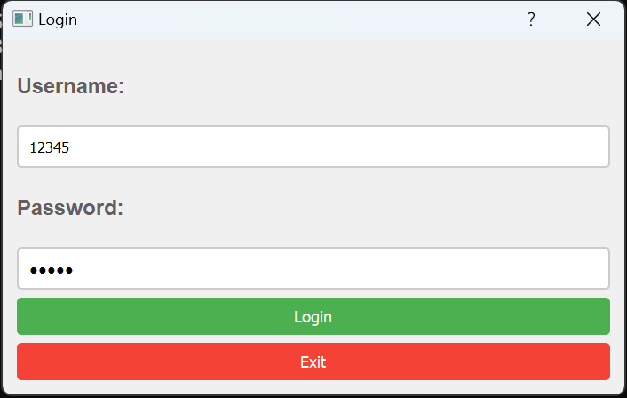
Emphasize that Maya is designed to be accessible only to the authorized owner, keeping personal information safe.
In the context of Maya, login authentication serves as the first layer of security. As MAYA is an personal assistant it should be accessed only by its owner .
This means that before users can access any of Maya's functionalities, they must prove their identity by providing valid login credentials. These credentials typically consist of a username and a corresponding password.
Without successful authentication, access to Maya's main functionalities is restricted.

Slide 21
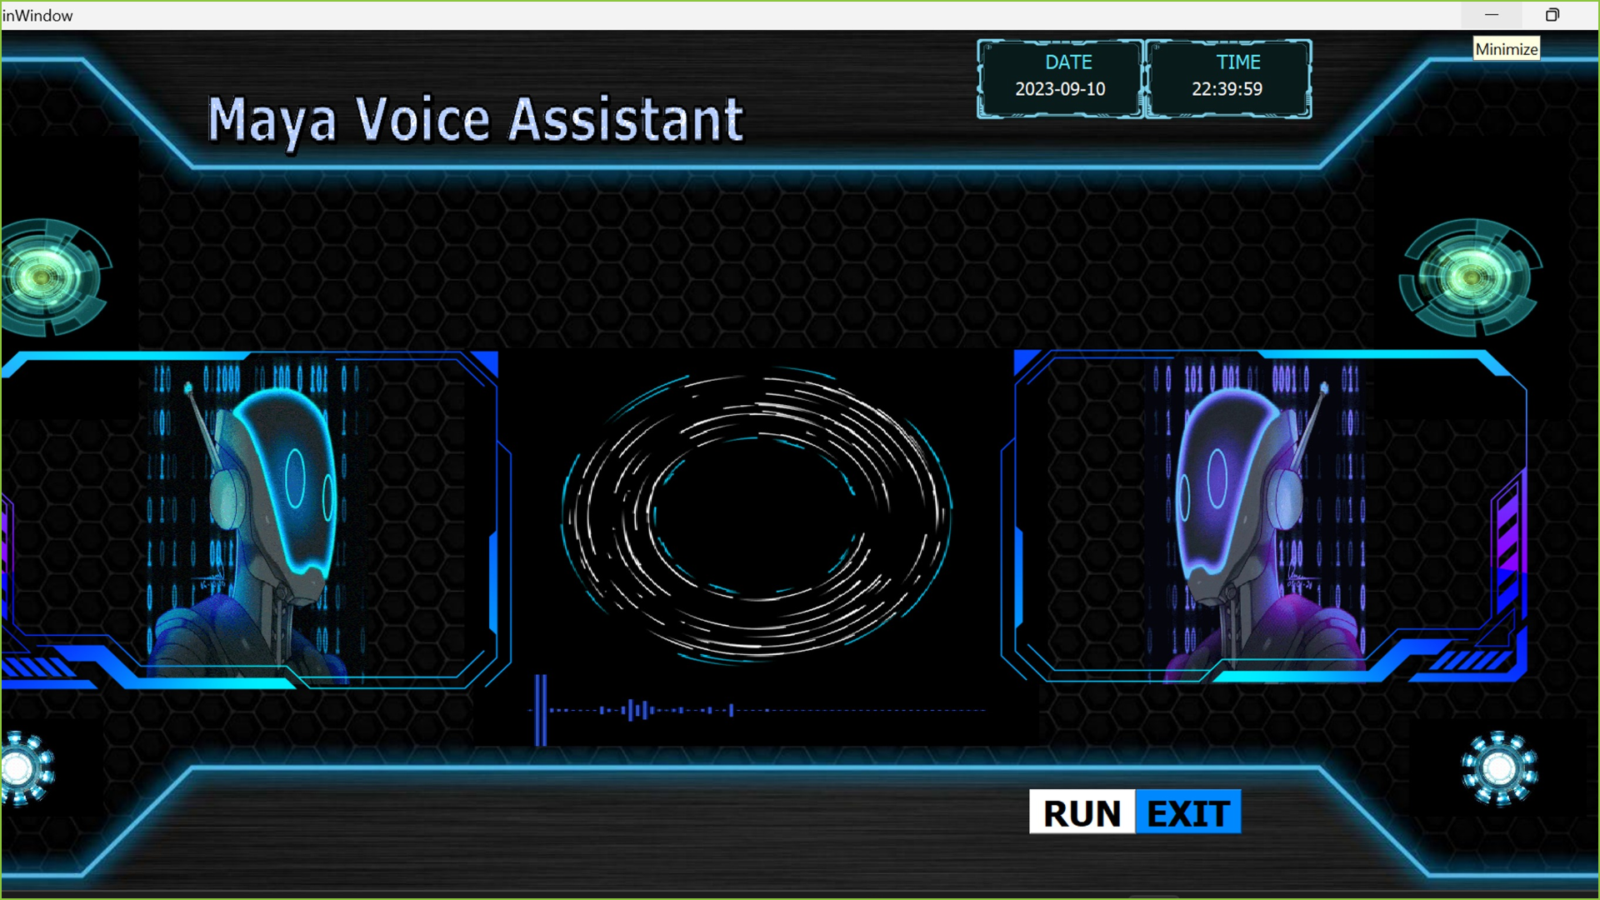

Slide 22
Future Improvements
Multi-Lingual Support :- Expand MAYA's language capabilities to serve a more diverse user base. Prioritize languages based on user demand and regional relevance.
Voice and Speech Improvements :- Invest in improving MAYA's voice recognition accuracy. Offer a variety of voices and accents for a more inclusive experience.
Integration with Smart Home Devices :- Work on expanding MAYA's compatibility with various smart home devices, enabling users to control their loT devices effortlessly.

Slide 23
Conclusion
Enhanced Productivity :- MAYA streamlines tasks, allowing users to perform various actions quickly and efficiently using voice commands. This enhances productivity, especially for multitasking individuals.
Accessibility :- MAYA is inclusive, catering to people with disabilities or those who prefer voice interactions. It ensures accessibility for a wider user base.
Time-Saving :- Users can perform a variety of actions, from setting reminders to answering questions, without manually navigating through applications or websites, saving valuable time.
Personal Assistant :- MAYA acts as a personalized digital assistant, helping users with daily tasks, such as setting schedules, finding information, or managing devices.

Slide 24


